Slide 1
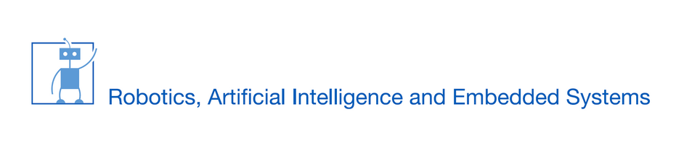
Simulation Based Autonomous Driving
Nikola Nincic and Philipp Kutschmann

Slide 2
Introduction
Timeline of the project:
Get first Simulator running
Develop own end2end model for autonomous driving
Second simulator with advanced scenes
Retrain and improve previous model
Add more functionality to handle complex scenarios

Slide 3
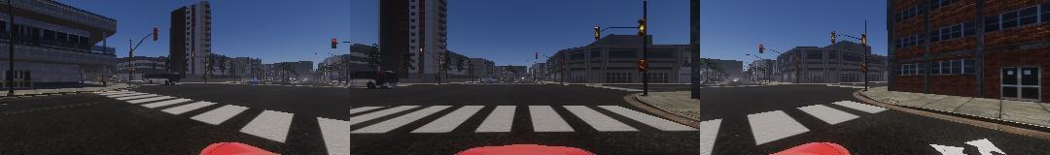
The method
End-to-End
Simulator
Steering angle
Brakes
Throttle
CNN

Slide 4
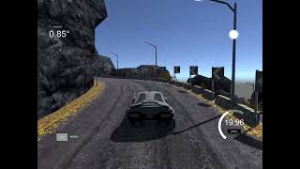
Demo First Simulator

Slide 5
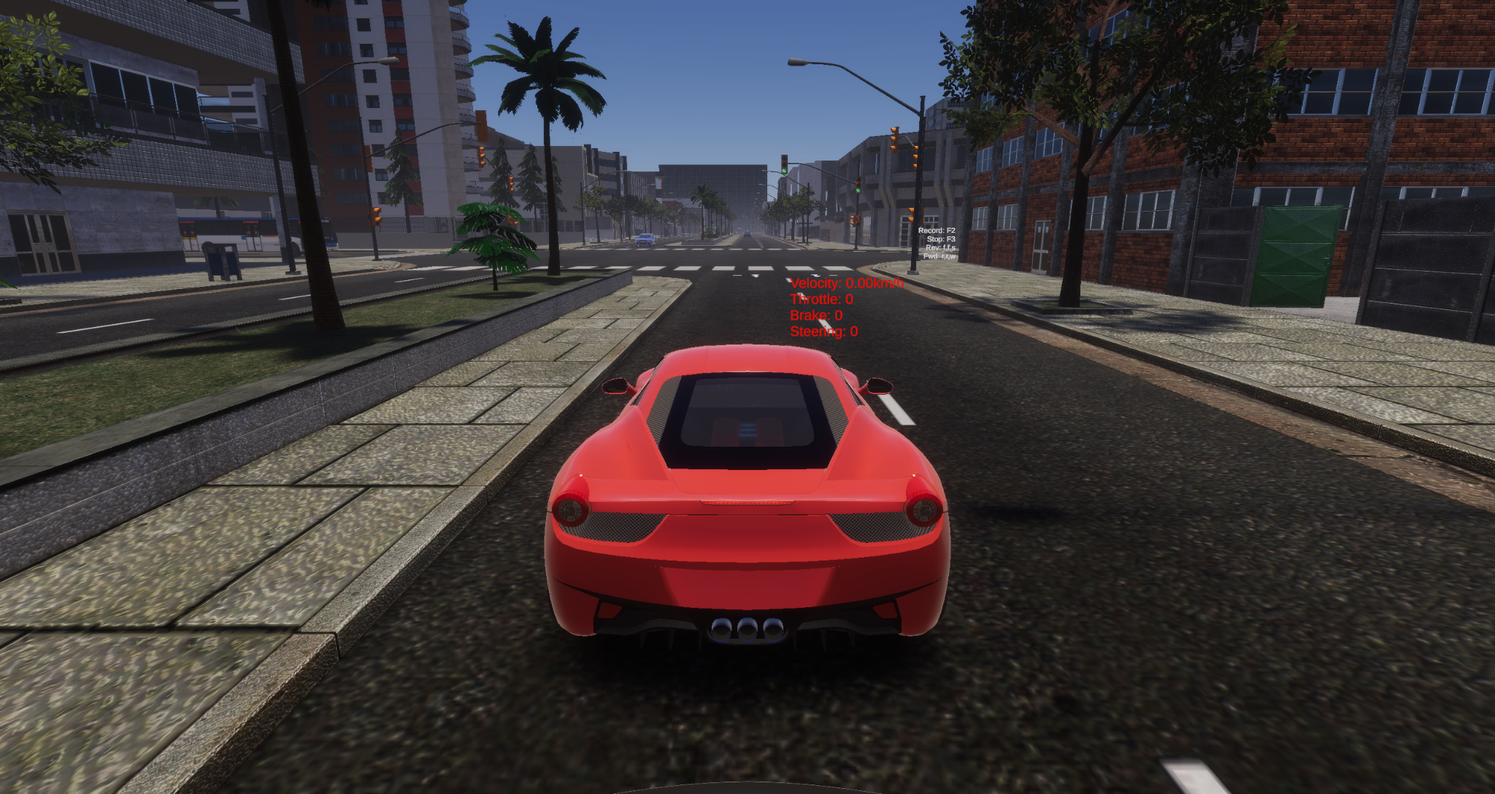
Second Driving Simulator
New Features
Realistic street structure
Other traffic participants
Traffic lights

Slide 6
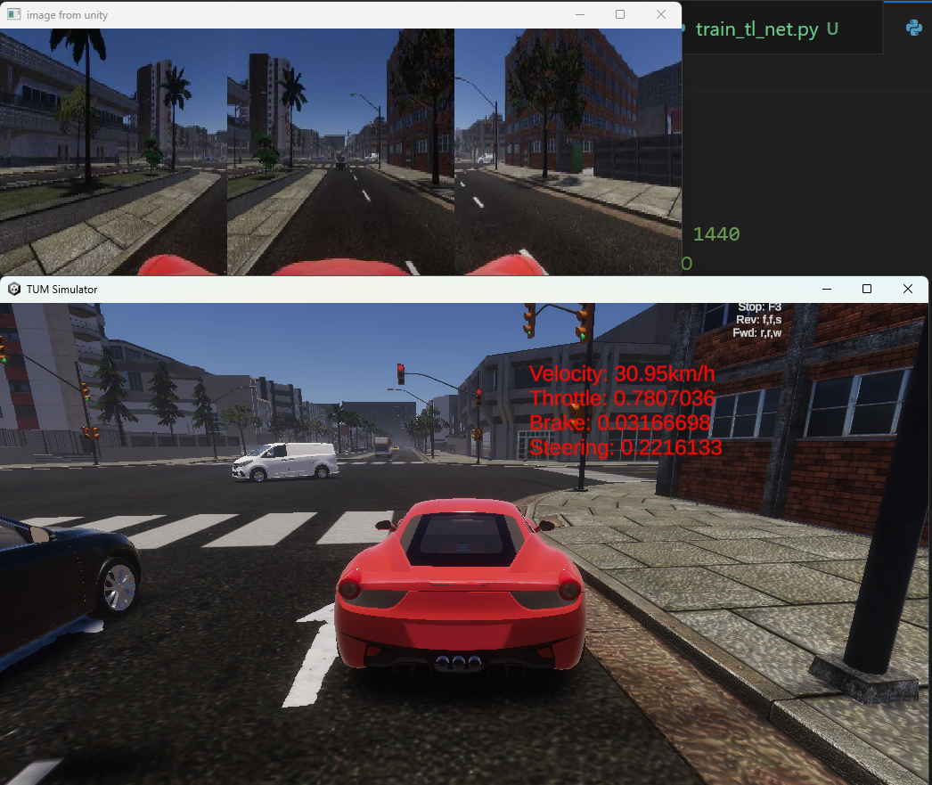
Second Driving Simulator
Issues
Large delay
Low image resolution
Resolution and aspect ratio of recording and testing differs
Other cars disobey traffic rules
Low frame rate even on stronger GPUs

Slide 7
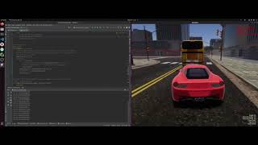
Crashes

Slide 8
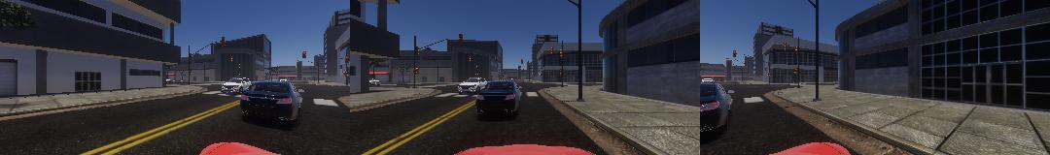
Issues with the end-to-end method
Detect traffic light state in time on low resolution
Determine speed of other cars to make a valid decision if breaking is necessary
Determine which way to go on intersections → Our solution: Train model to drive on a specific route on the map

Slide 9
Our additions to the end-to-end approach
YOLOv8 for object detection
Custom dataset of 200 sample to train a model for traffic light state detection
→ majority vote of detected traffic lights to choose action
green
red
ignore

Slide 10
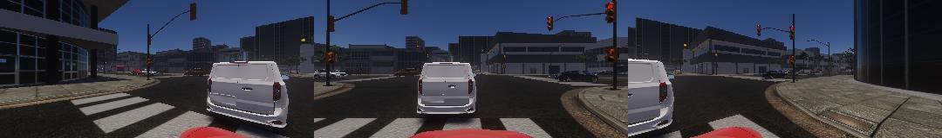
Our additions to the end-to-end approach
YOLOv8 for object detection
2. Detection of other traffic participants in front of the car

Slide 11
Live Demo second Simulator

Slide 12
Future ideas to solve the issues
Method
Use network that can handle sequential data (e.g. LSTM or Transformer)
Add sensors to car to measure speed of other traffic participants
Add map and global navigation to handle intersections and feed the action as additional input into the network
Simulator
Better performance of Simulator: Reduce lag and delay
Improve other cars to obey traffic rules
Higher output resolution of the images
Match image resolution during training and testing

Slide 13
Thank you for your attention!

